Slide 1
Lecture 1: Introduction to Computer Science
CSC111: Introduction to CS through Programming
R. Jordan Crouser & Shinyoung Cho
Assistant Professors of Computer Science
Smith College
jcrouser.github.io/CSC111

Slide 2
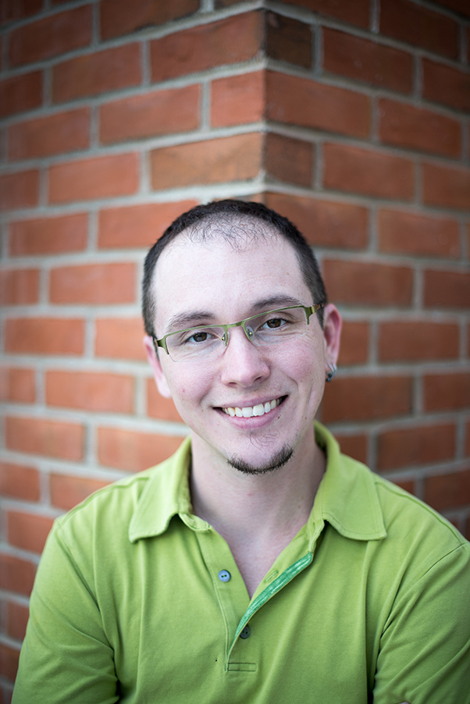
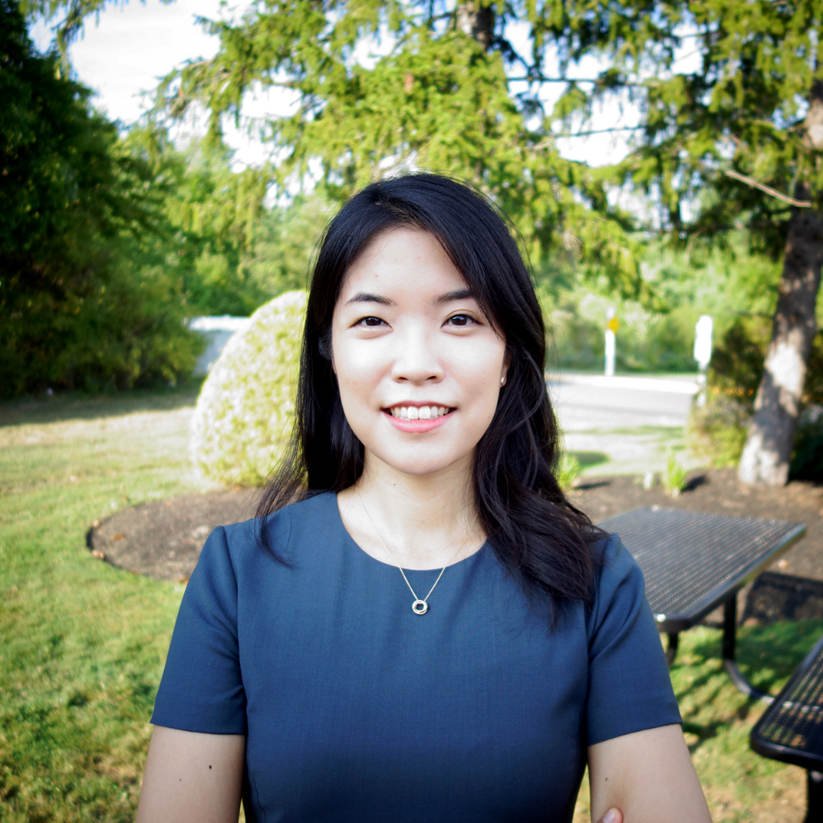
Introductions
Shinyoung
Jordan
Dave
Professor
Professor
Lab Instructor
Ali, Adriana, Emily, Allison, Sivan, Neamat, Chris, Ellen, & Ananda
(our team of Teaching Assistants)

Slide 3
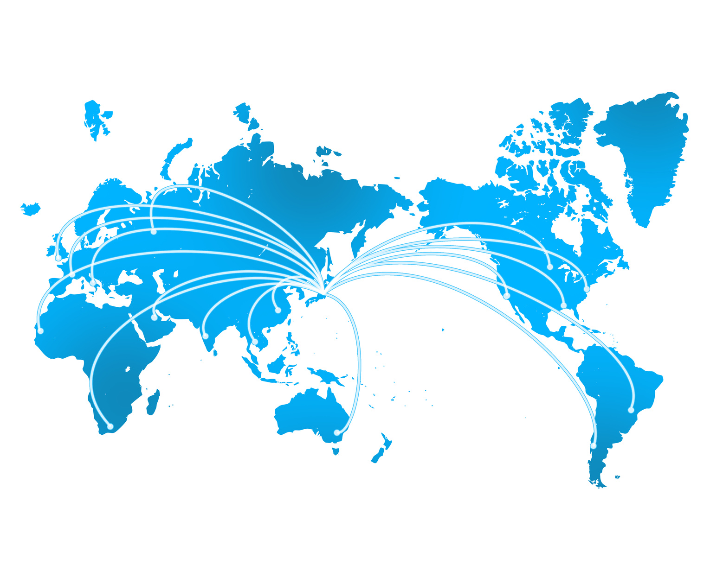


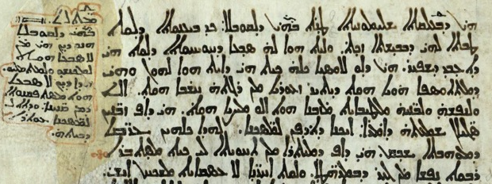
What I do: analytical tools for messy data

Slide 4
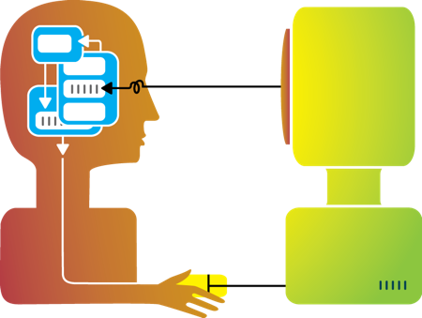
Big idea behind my research
Humans and machines have complimentary strengths
Visualization
Perception
and
context
Interaction
Computational power
Image credit: Ali Ansari

Slide 5
This course
How does this part work,
and how to we get it to do what we want?
Computational power
Image credit: Ali Ansari

Slide 6
Interesting (non-CS) thing to know about me
my hobby:
marine
aquaculture
(raising coral &
anemones)
Notes:
18 coral
12 bony fish
10 invertebrates
8 anemone
4 sponge
3 copepods

Slide 7
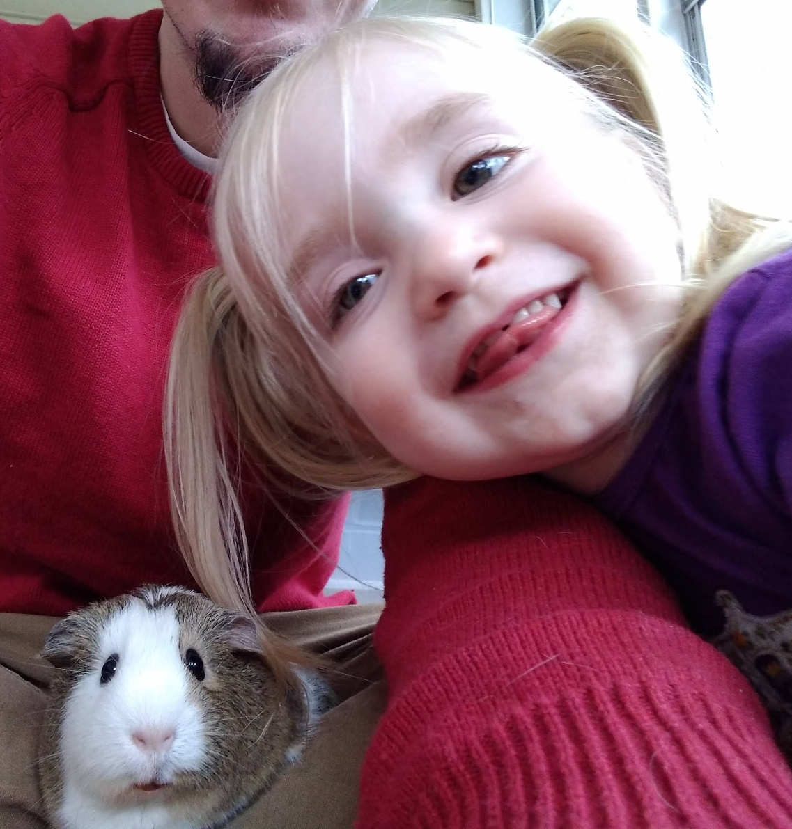
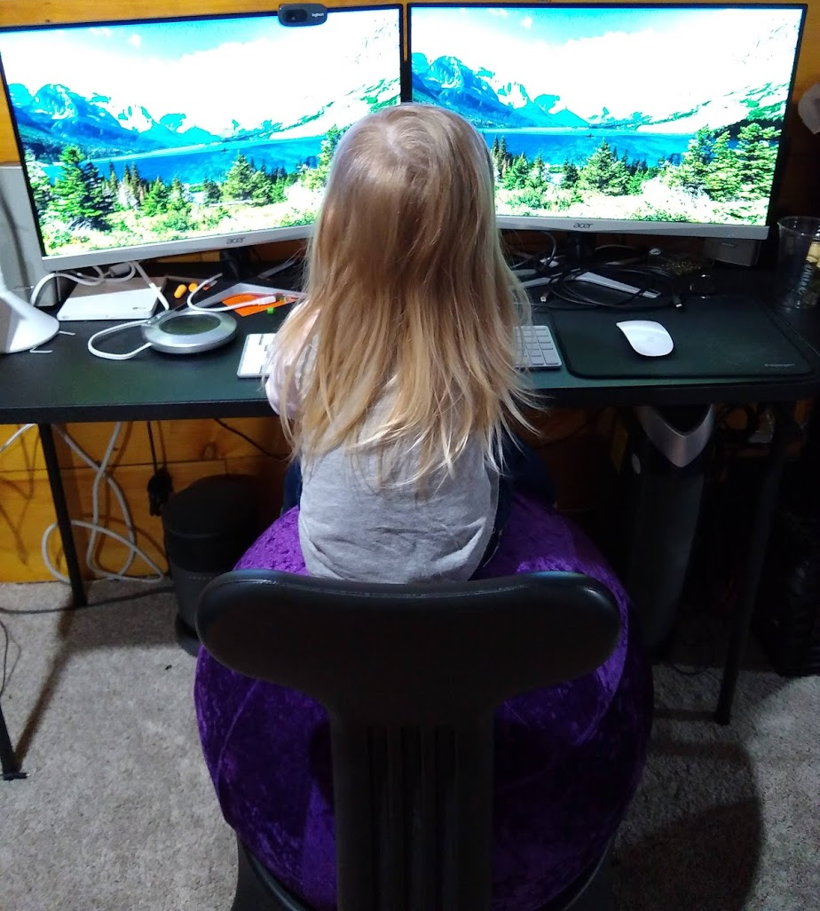
Way more interesting thing
“…I’ll probably come to visit later this semester,
I have lots of thoughts about computer science!”
Logan
(3 years old)

Slide 8




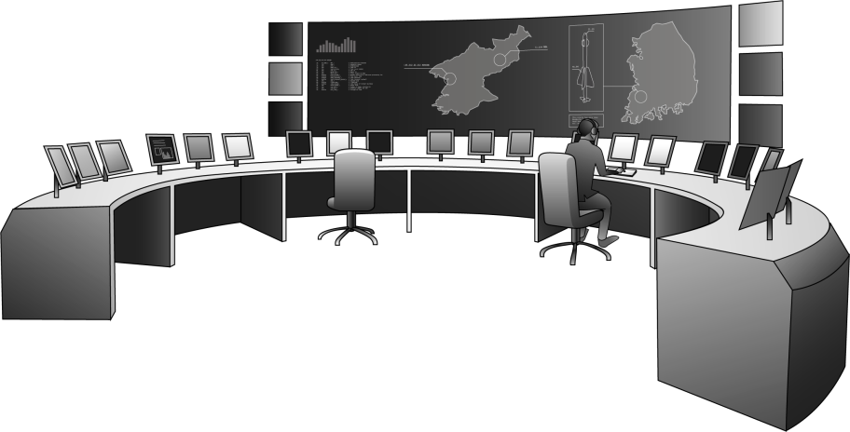
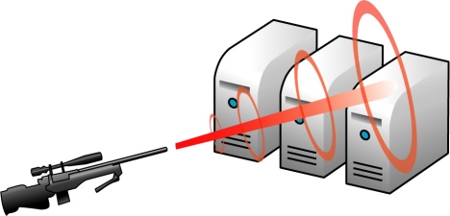


What I do: making data transmission a bit safer
Storage
Prevention
Detection
Monitoring
Notes:
How to transfer data one to another?
Security and Privacy in transferring data one to another
+1 (details)
Detection How to Mitigate at a global scale

Slide 9
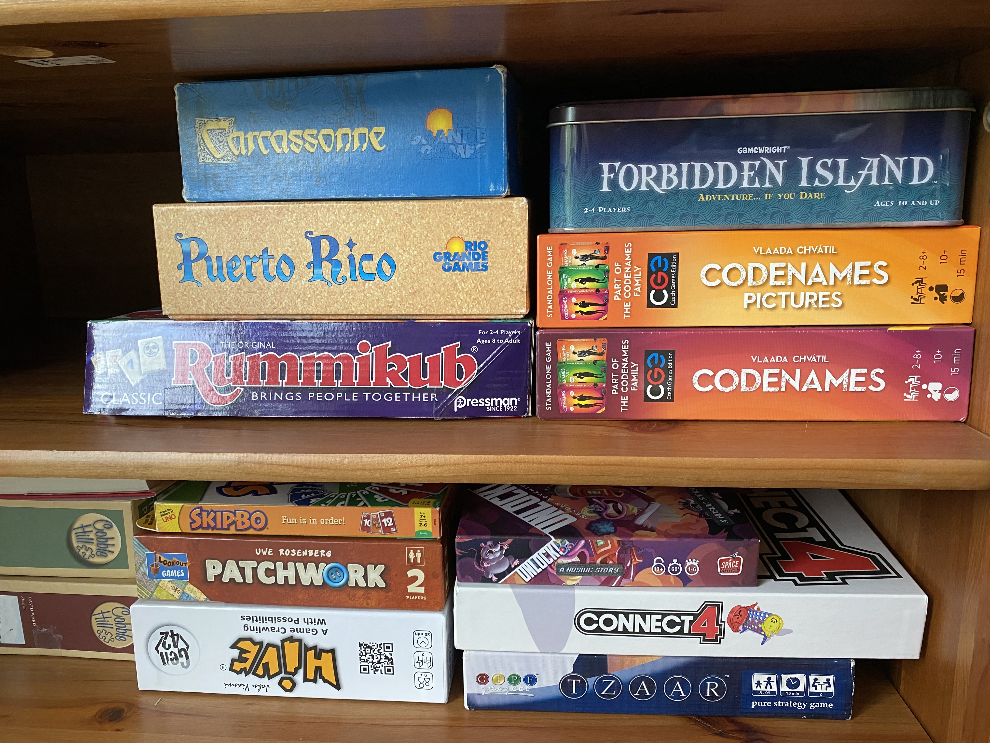
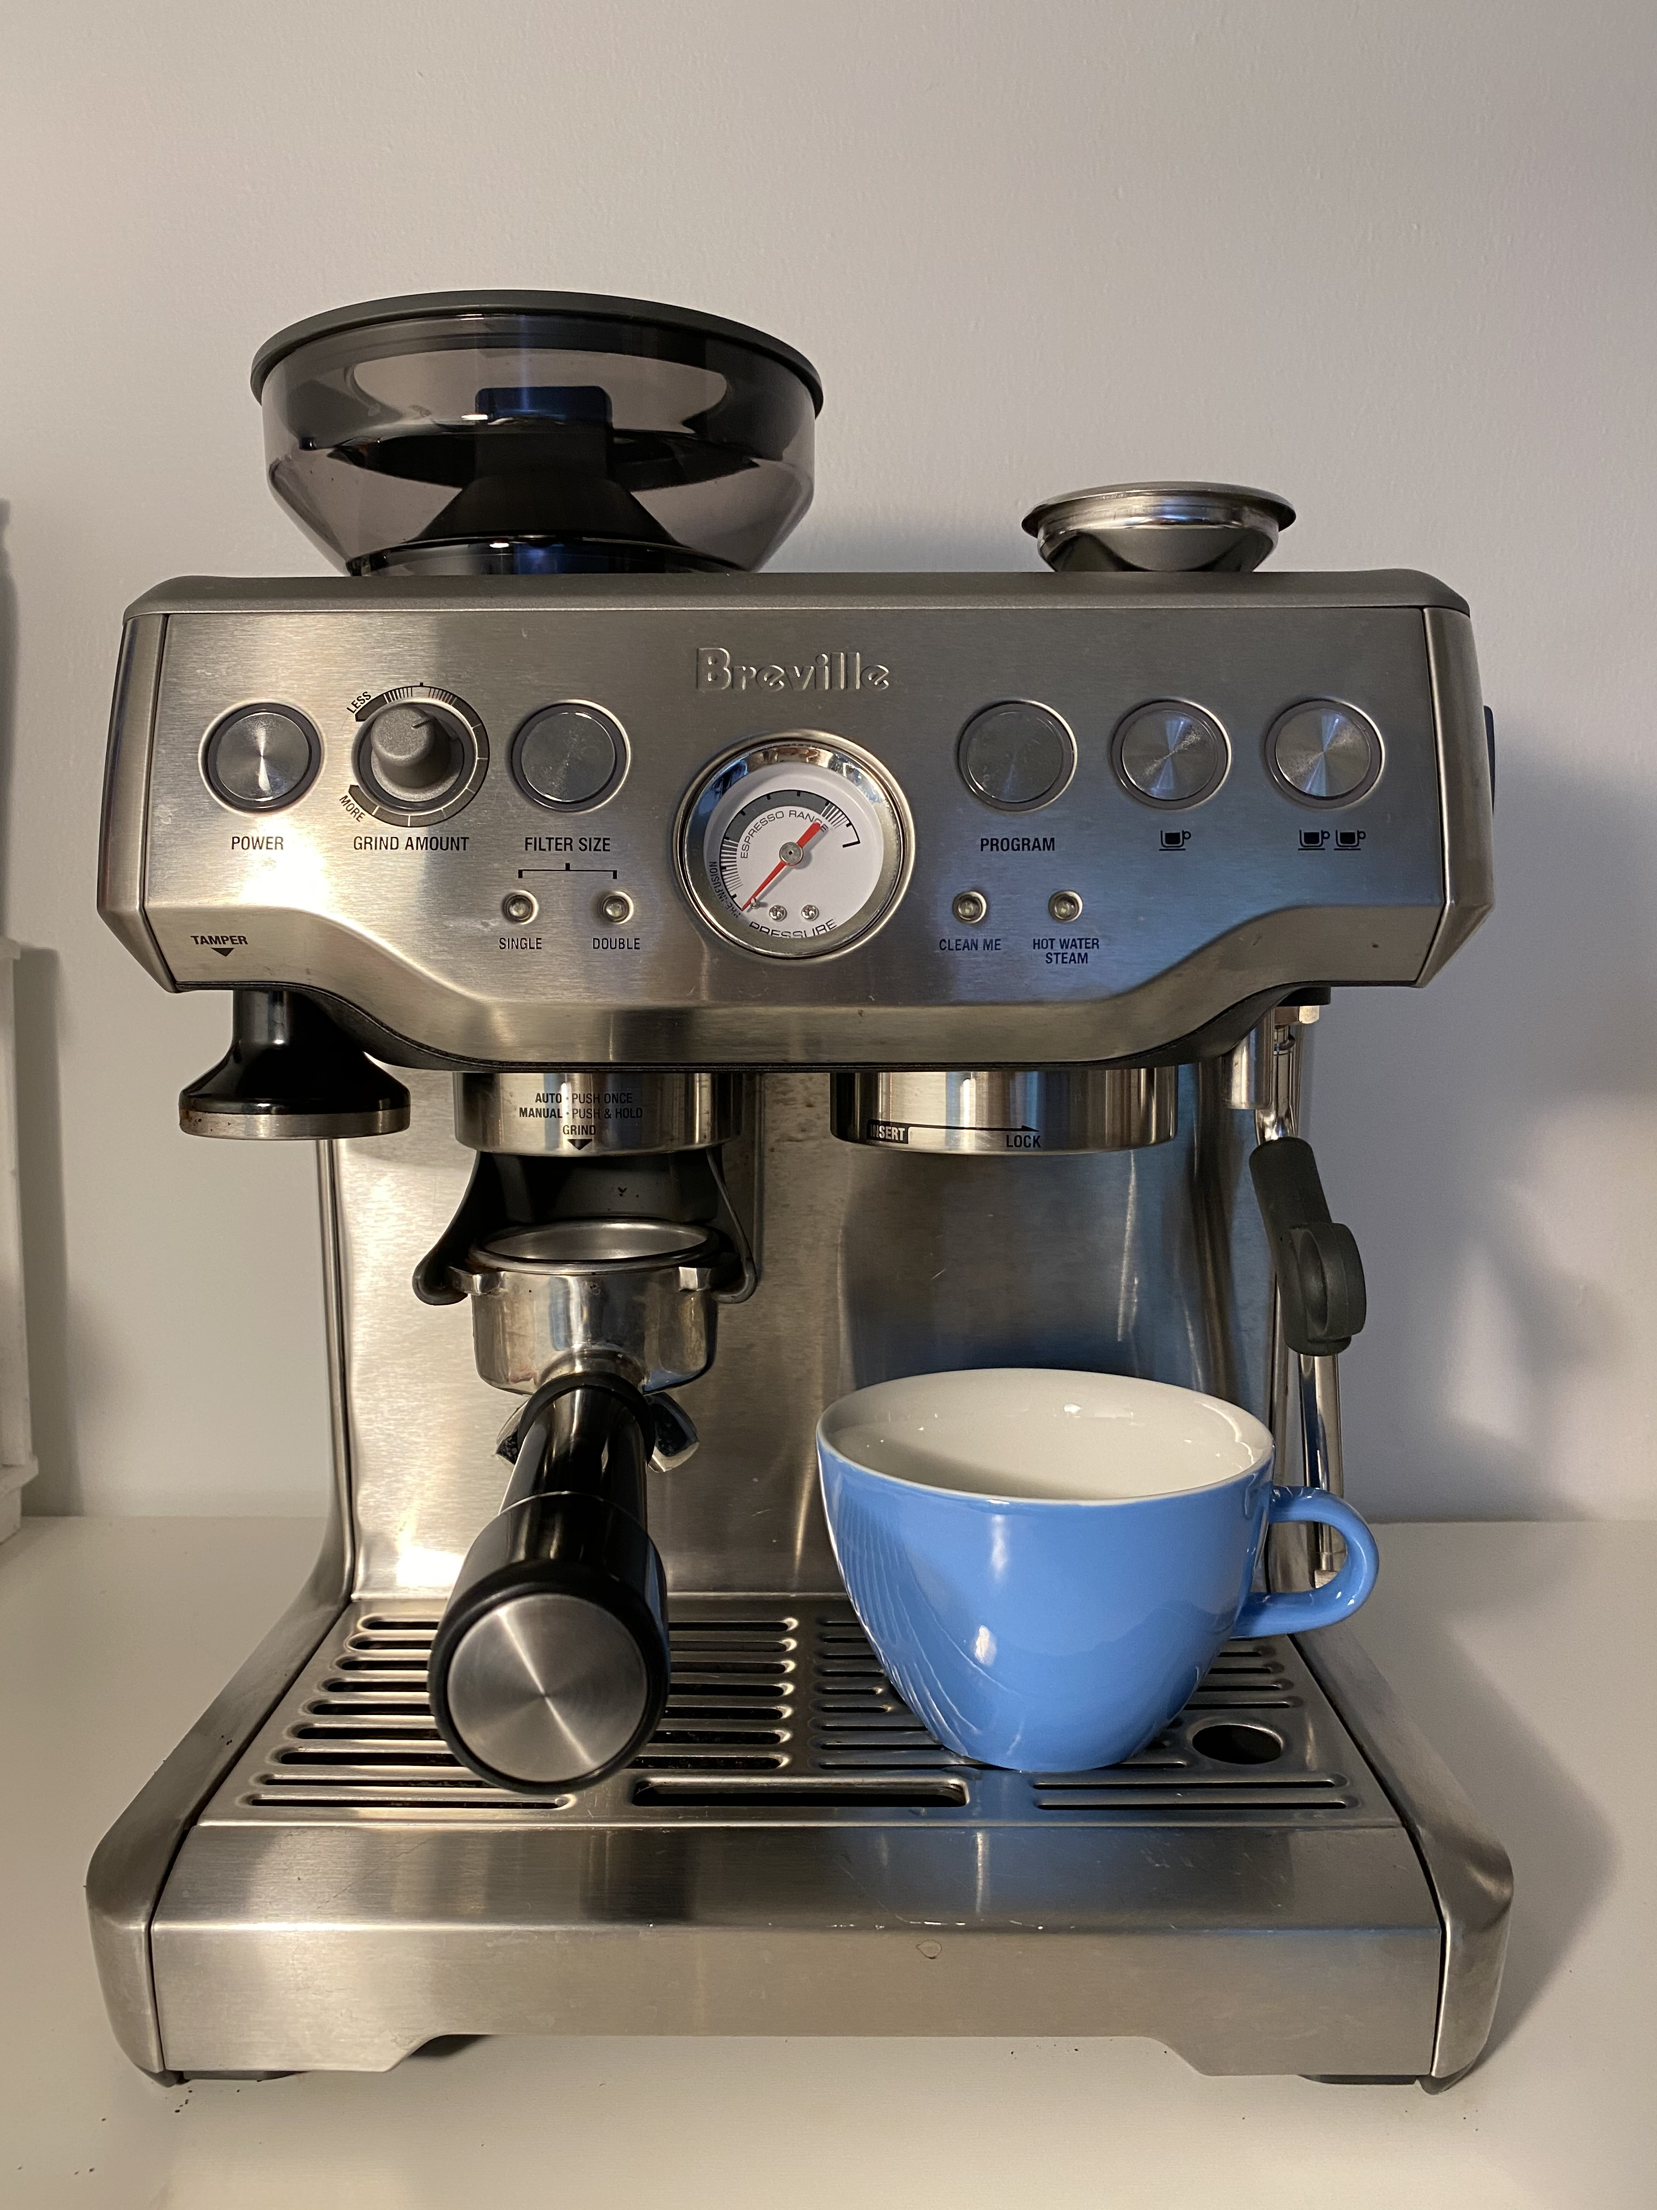
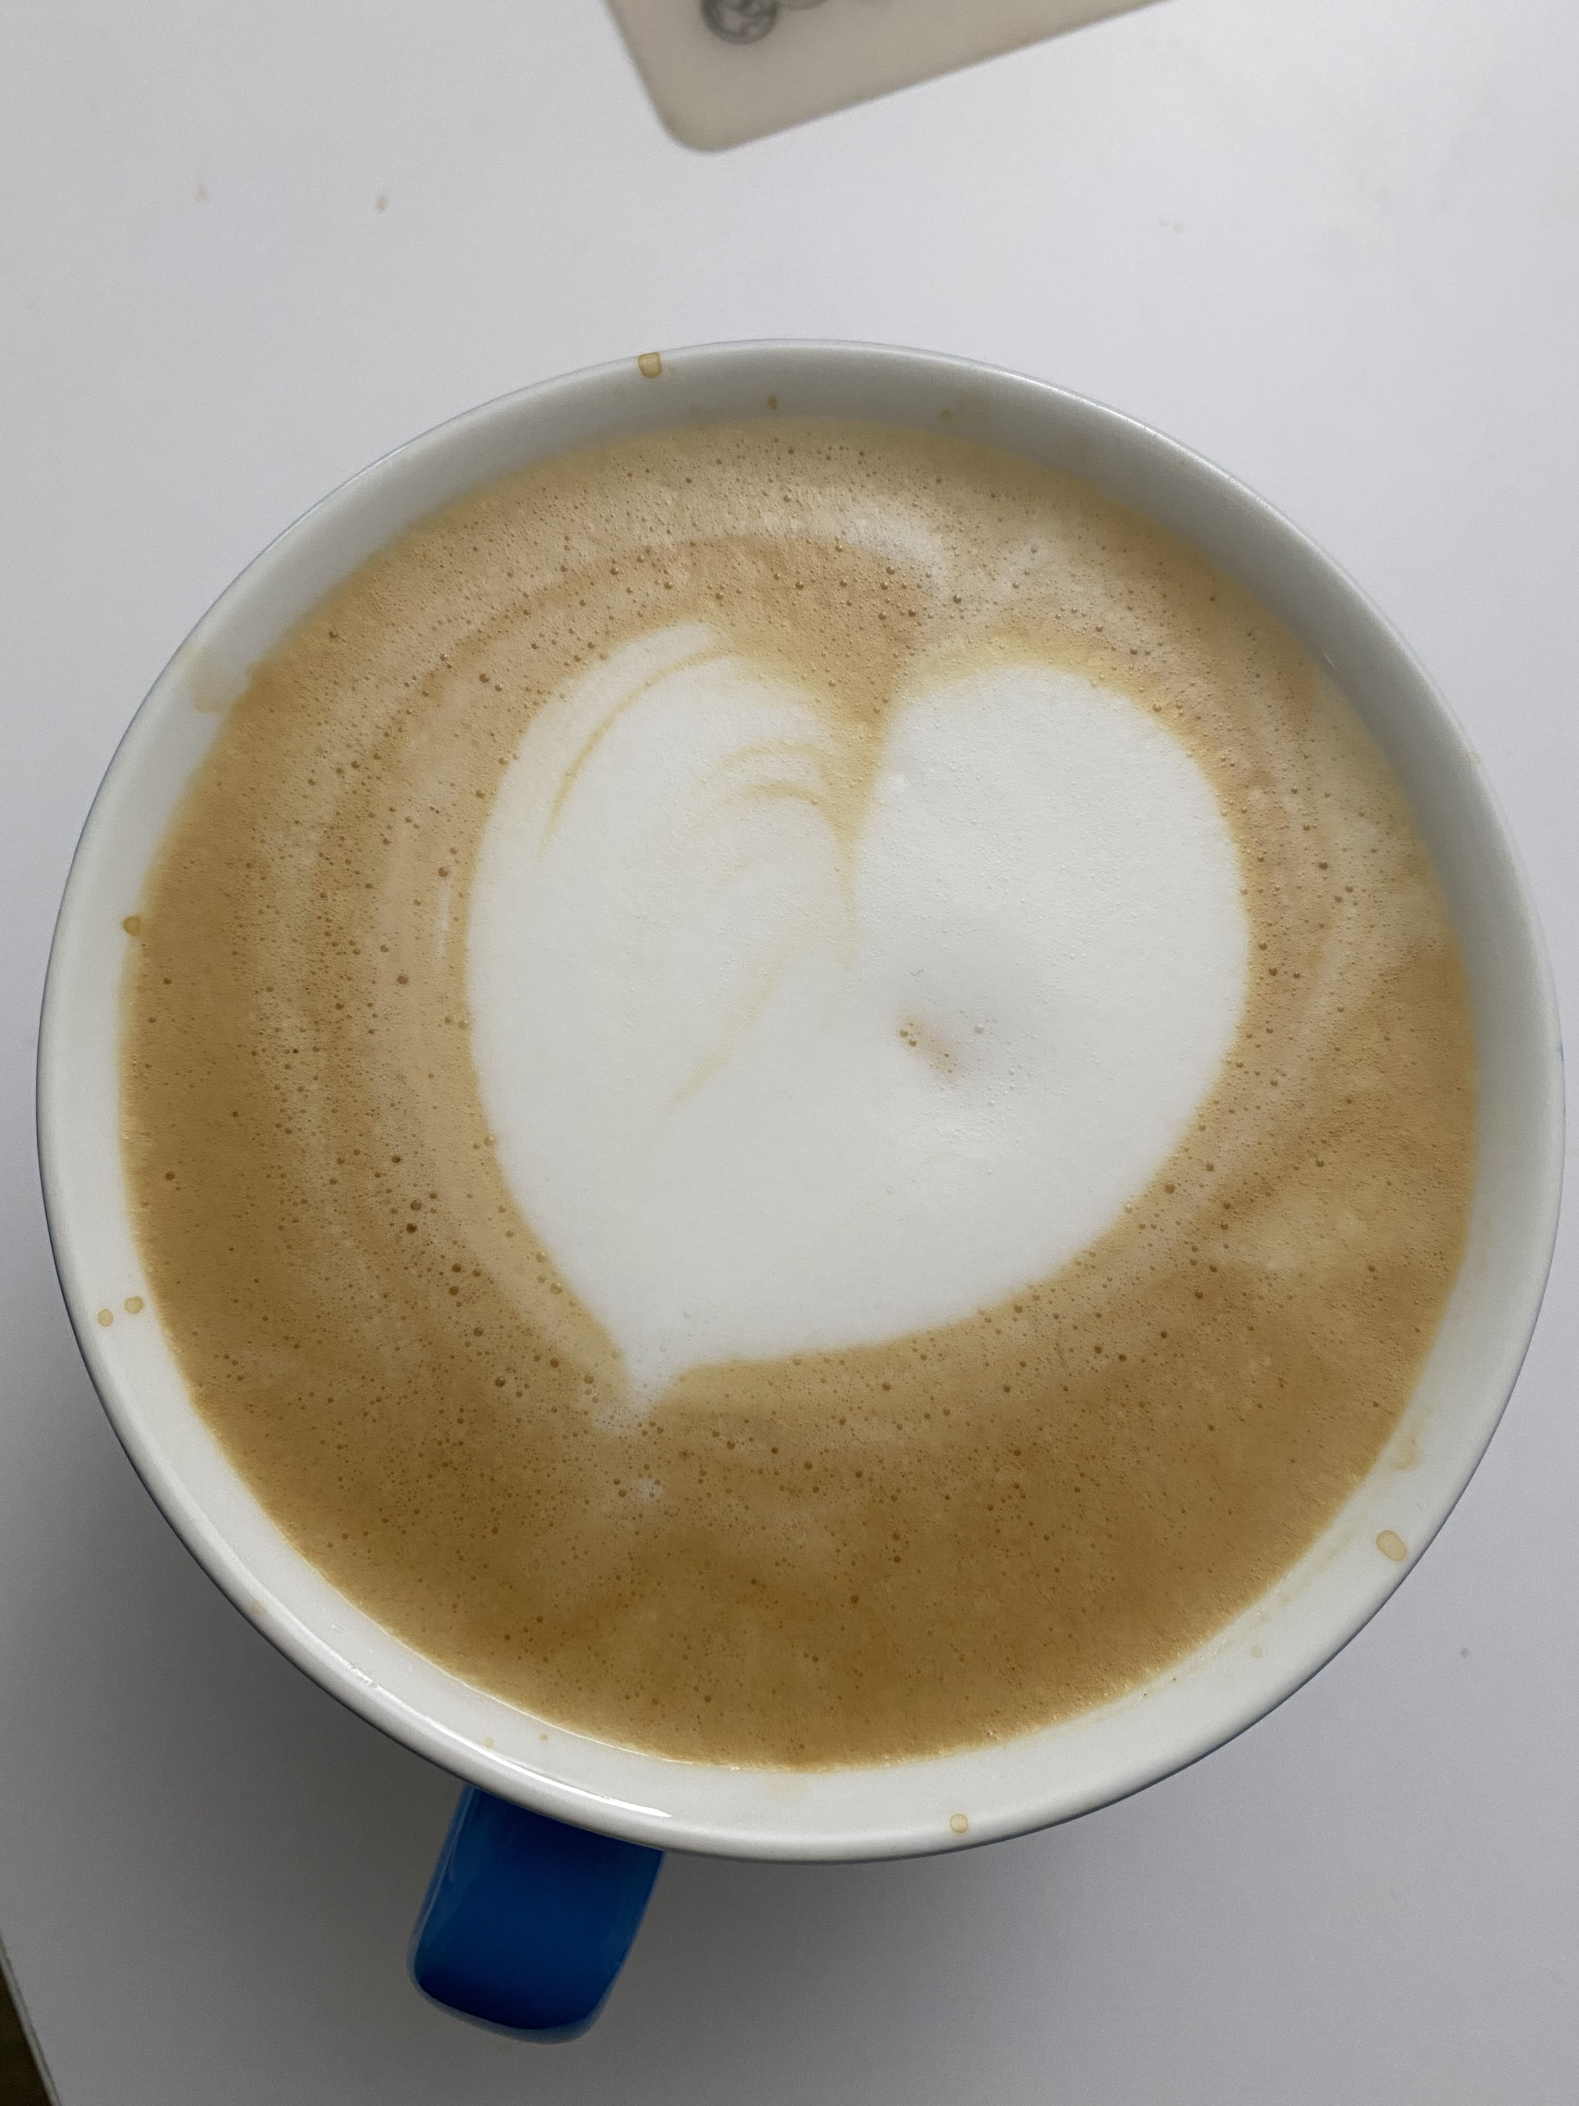
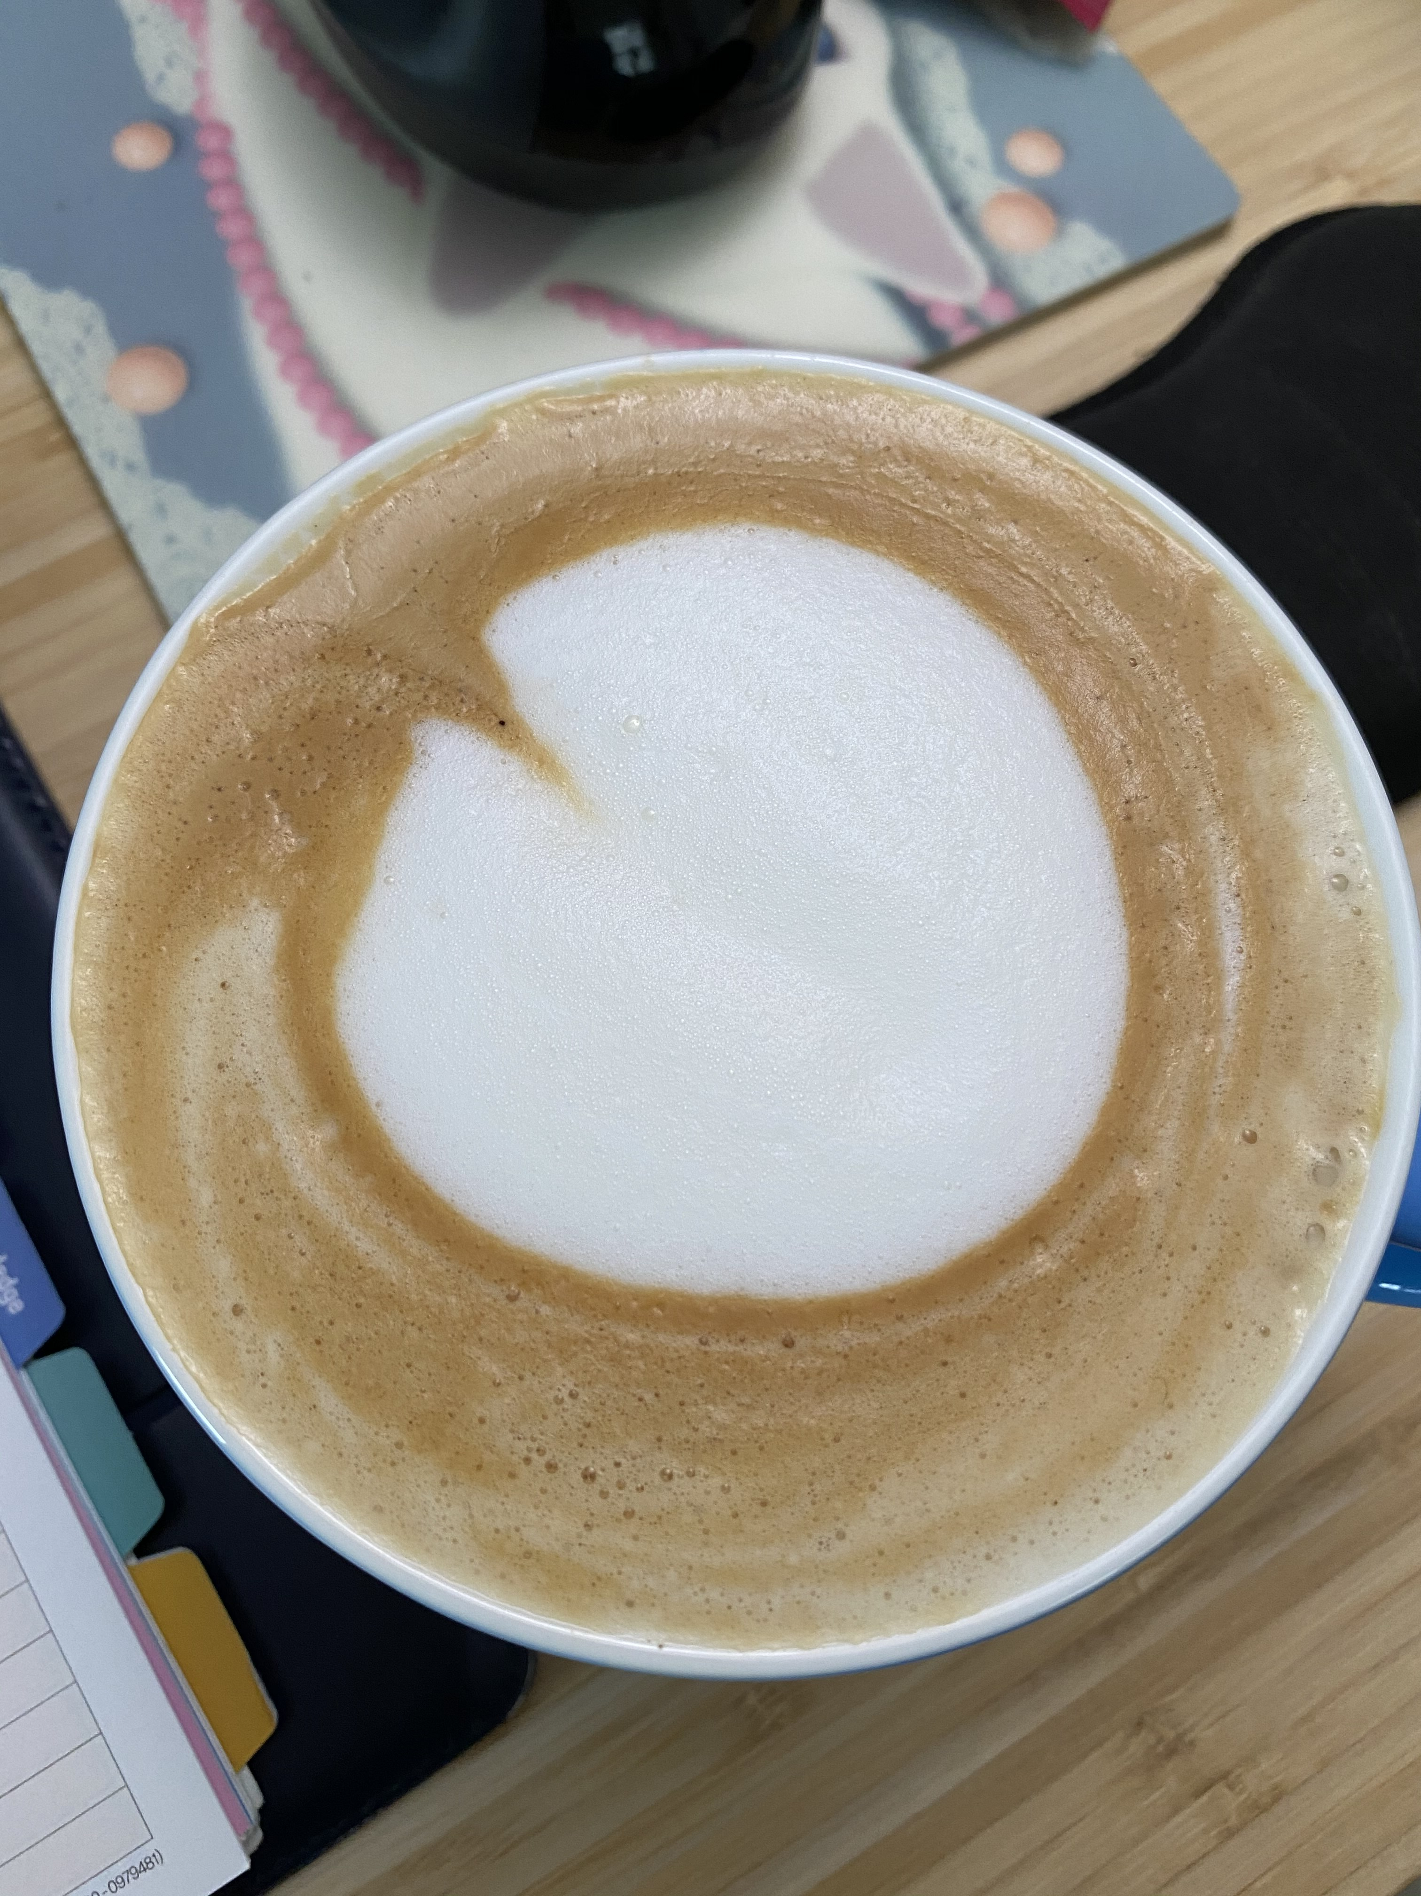
Interesting (non-CS) thing to know about me
I love playing
board games.
I’m a coffee
lover
(Beginner for latte art)
Notes:
Enneagram
Reading books

Slide 10
3-minute biographies
About you:
Your name and pronouns
Your class year
Your intended major / area of focus (if you know)
5 questions:
What brought you to this course?
What’s one big thing you hope to get out of it?
Anticipate any barriers to success this semester?
What’s one big question that sometimes keeps you up at night?
Want to join a study group?
bit.ly/CSC111-3-min-bio

Slide 11
Goals of this course
Learn basic
programming
constructs and
internal workings
of a computer
Explore
foundational
techniques
using
Python
Opportunities
to work together
on projects
you find
interesting

Slide 12
Rough structure of the course
Monday and Friday lectures:
Introduce a new idea
Mini-lab / activity
Brief discussion
Set up the assignment for the week
Asynchronous labs (out Monday, due Wednesday)
Hands-on practice with ideas from lecture
Wednesdays: learn/practice a CS “Life Skill”
End of the semester: group project (more on this later)

Slide 13
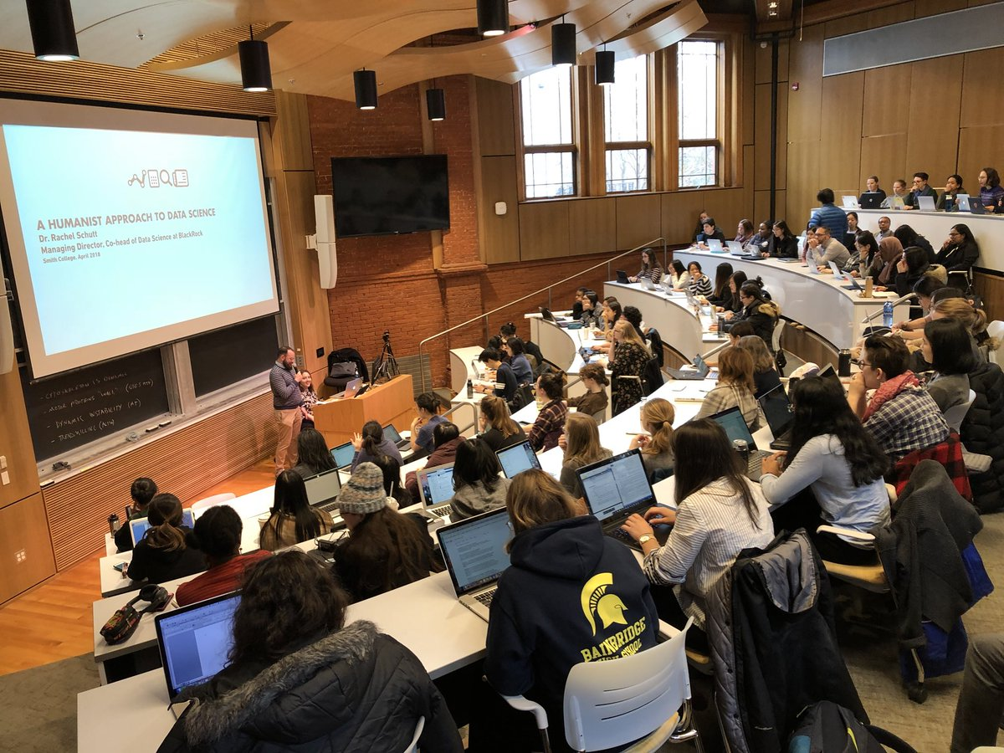
Setting expectations

Slide 14
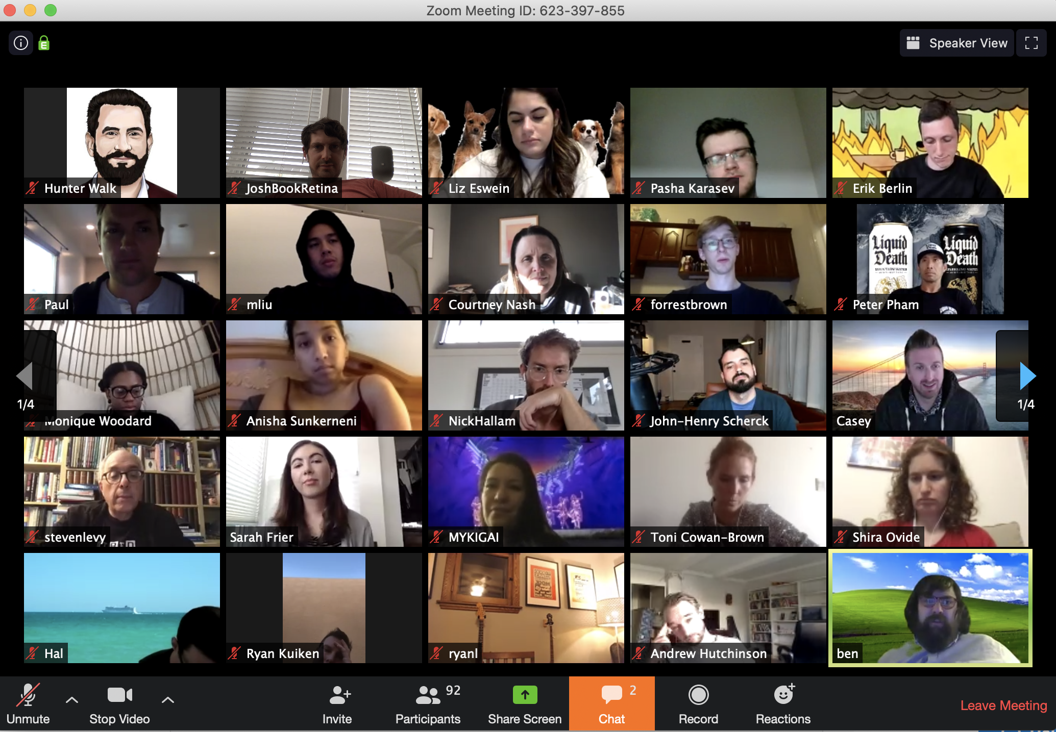
Setting expectations

Slide 15
Outline
Introductions
Goals / structure
Big questions for this course
Activity: computational thinking
Resources and details

Slide 16
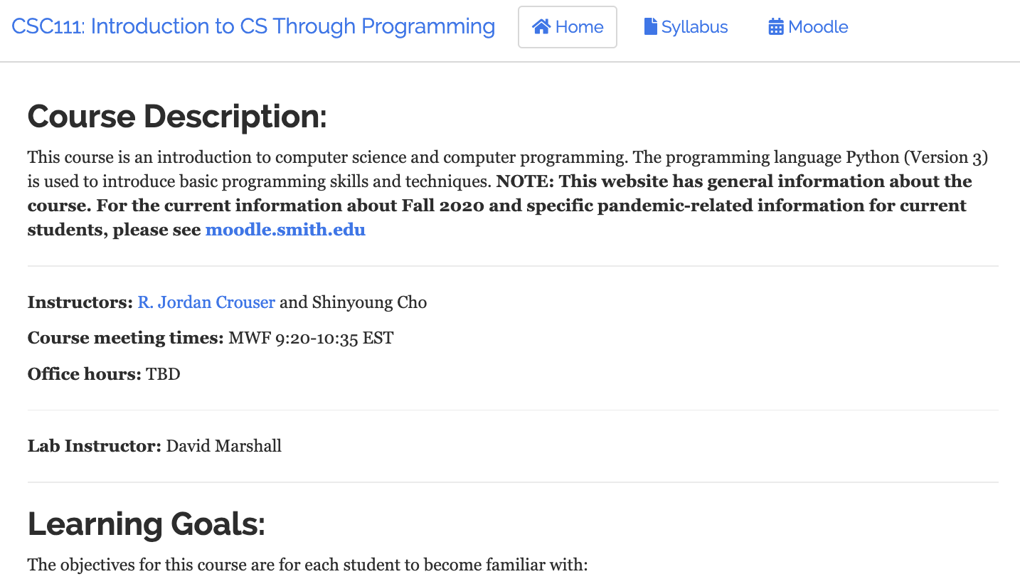

Quick question…
#protip
in classes with Jordan,
this icon means
“your turn to talk”

Slide 17
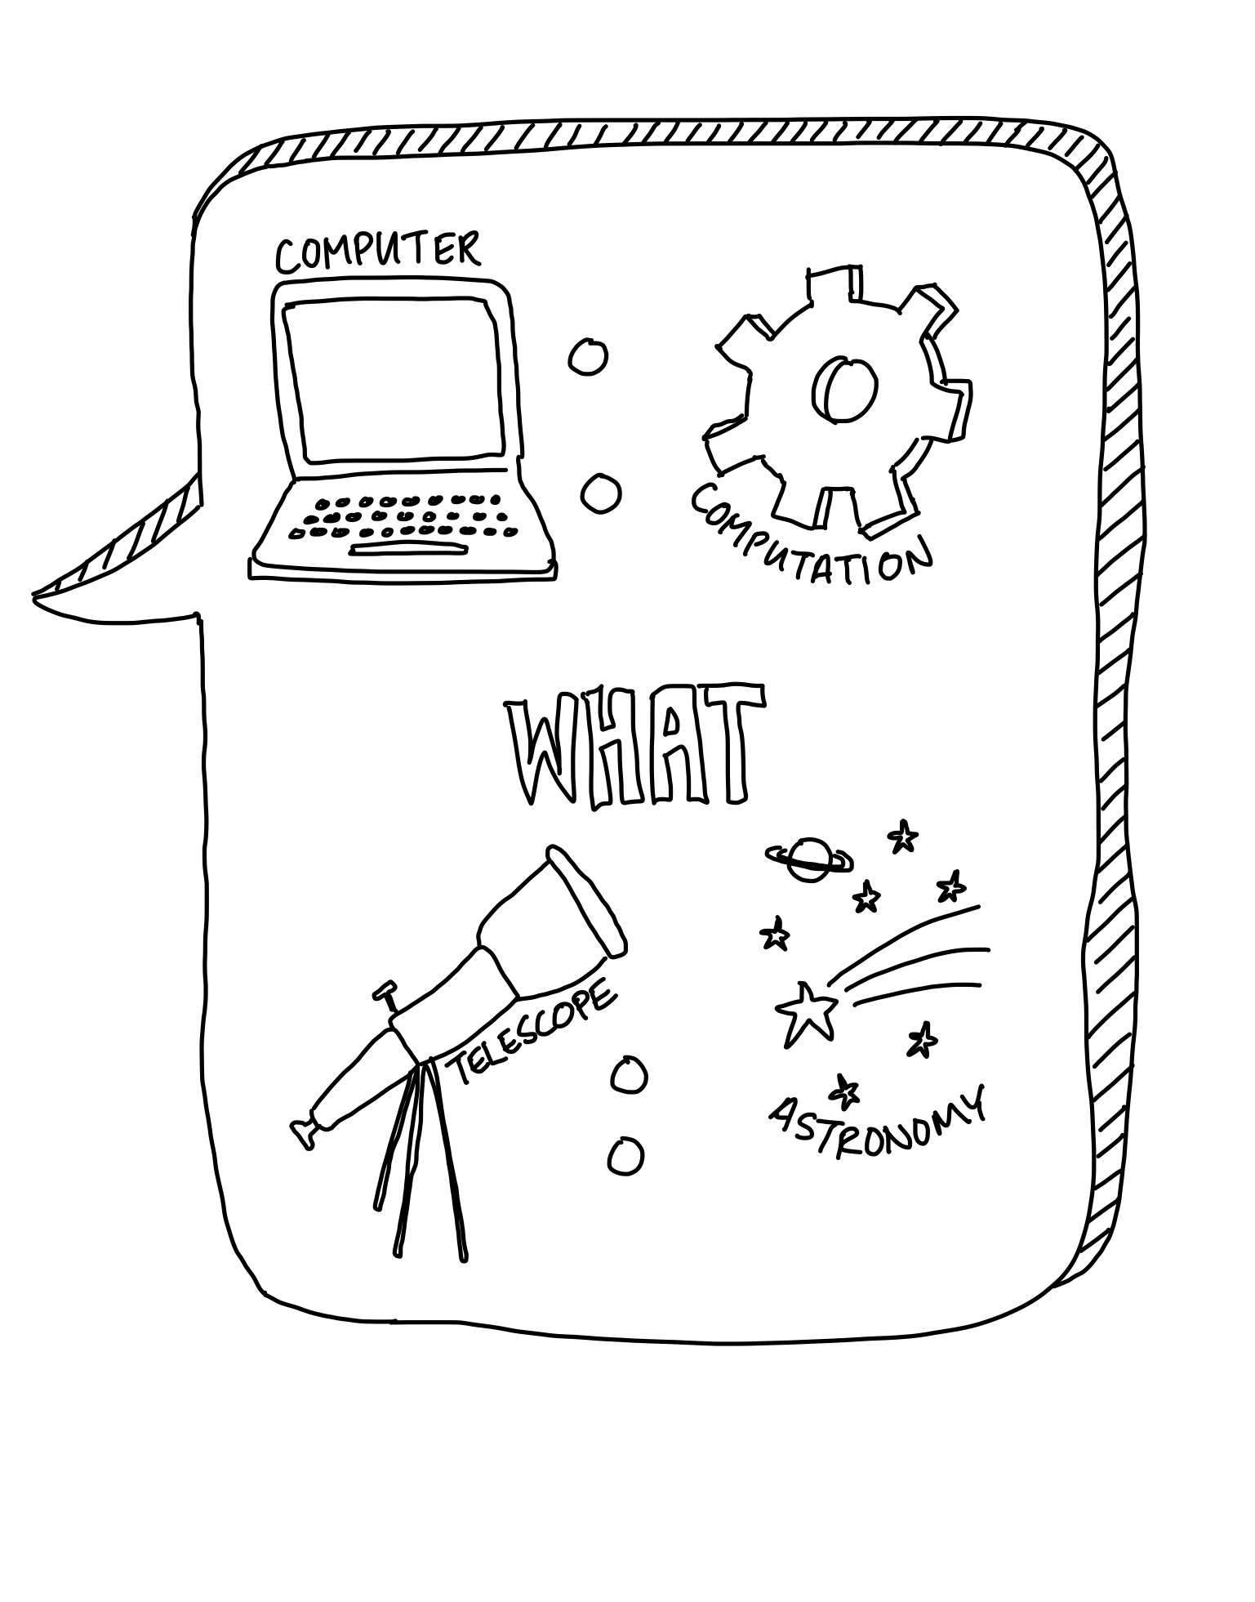
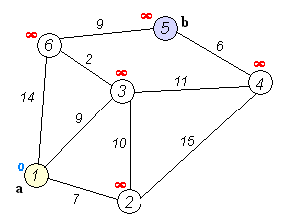
Computer science ≠ “computers”
Edsger
Dijkstra
Notes:
If CS is not the study of computers, what is it?
To answer this question, let’s first ask what computers are, and what they can do -- then come back to the main question of “what is computer science?”
Let’s start with a quick history lesson…

Slide 18
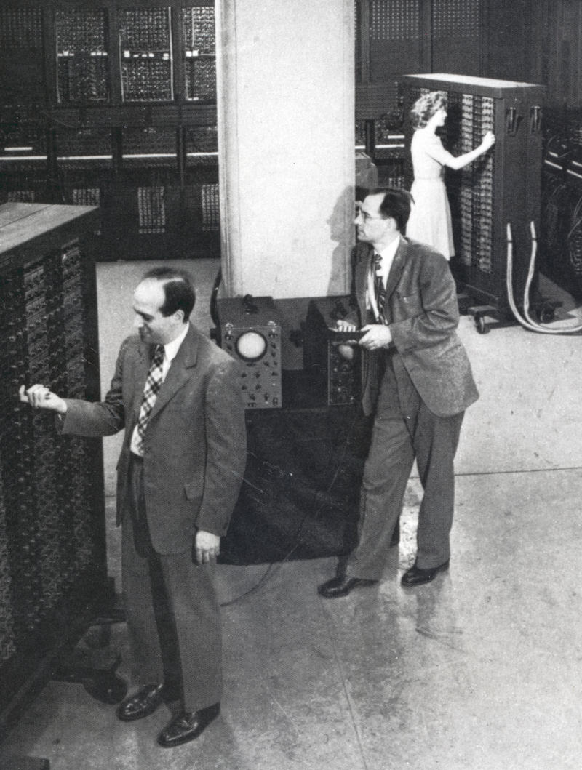
1950s: “Electronic Brains”
www.computerhistory.org
The slides in this section are based on copyrighted material from Explorations in Computing: An Introduction to Computer Science, by John S. Conery.
Notes:
When computers first started being widely used in the 1950s the general public viewed them as “electronic brains”
they were huge, expensive, mysterious
found only in the largest corporate, government, or university labs
sci-fi movies exploited this “electronic brain” viewpoint
Why a “brain” instead of some other metaphor?
the calculations performed by computers were the sorts of things only highly trained people were able to do
example: compute the trajectory of a rocket

Slide 19
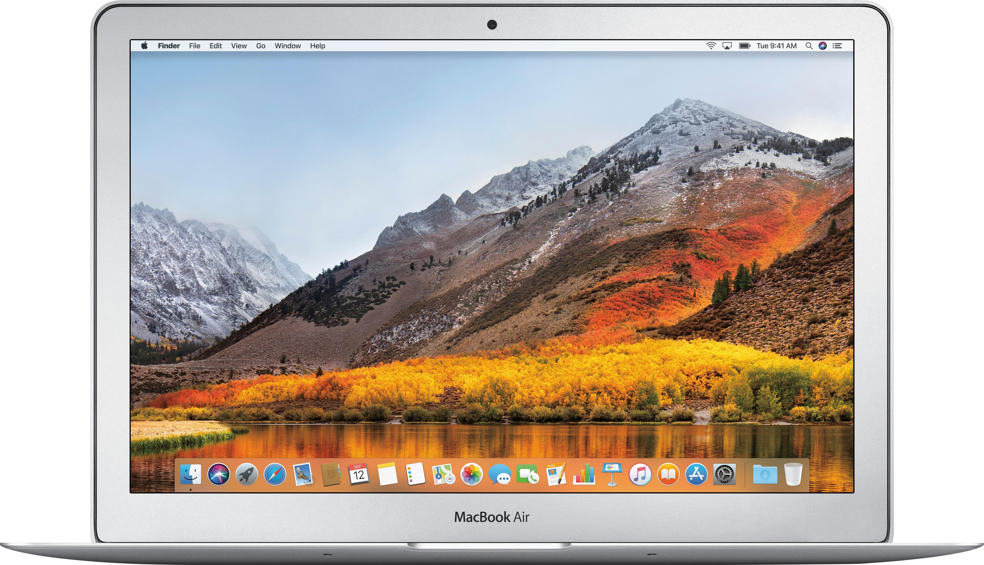
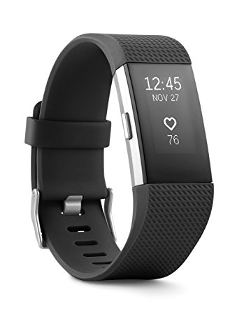
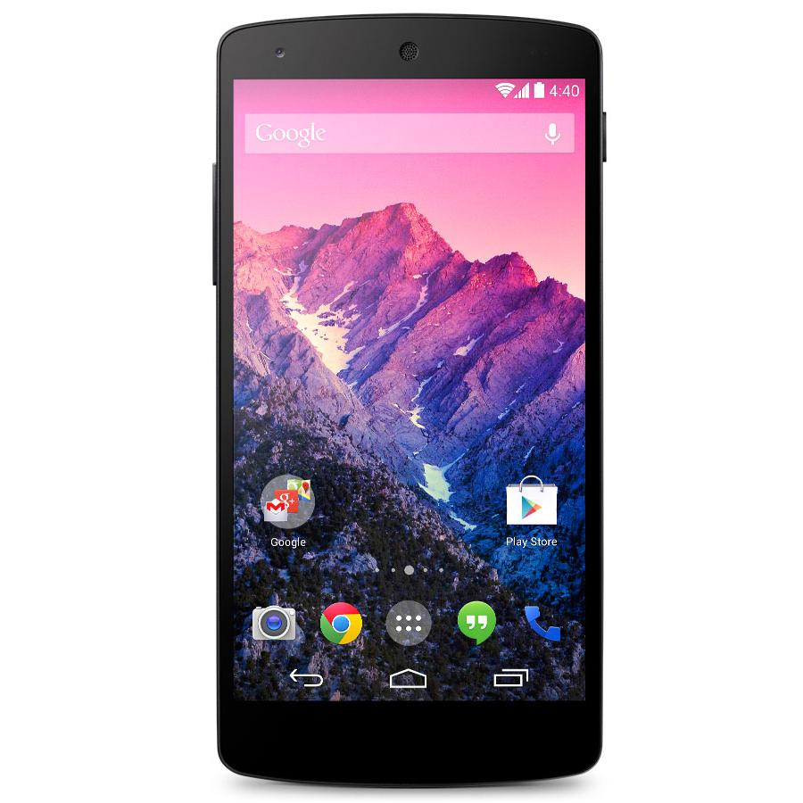
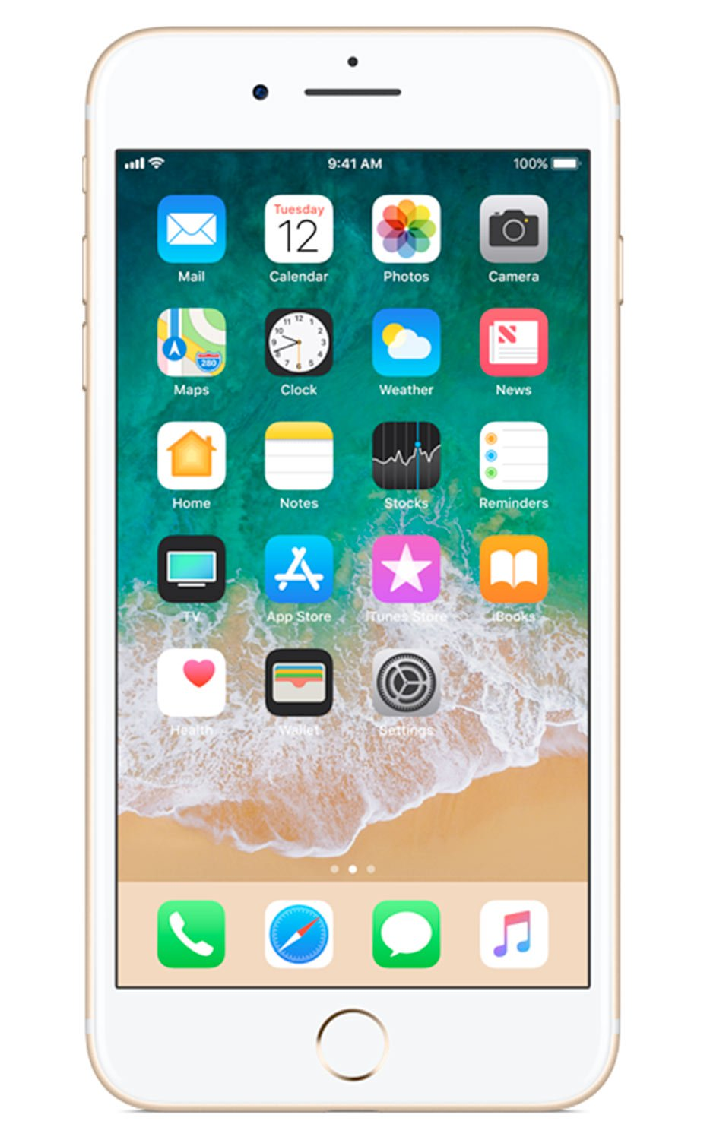
2018: “Appliances”
Essential tools in modern society
Personal computers (desktops and laptops)
write papers, manage personal finances, ....
entertainment: games, video, audio, ....
Business computers
day-to-day operations: payroll, billing, ...
customer service: web sites, customer data, ...
Embedded computers
microchips used as controllers in cars, phones, wearables, ....
Supercomputers
large “number crunchers” used in scientific research and other areas
parallel processing: from a few dozen to a few thousand CPU chips

Slide 20

Things computers can’t do
Notes:
One way to approach the question of “what is a computer?” is to look at some of the things we don’t expect a computer to be able to do
Problem 1: Choose a college or university to attend
Would you trust a computer to solve this problem for you?
several factors are involved, many of them hard to quantify
you don’t expect another person to solve this problem for you, either
the issue here is not the computer, it’s the nature of the problem
in order to “compute” the best choice you would need to be give a precise weight to each factor

Slide 21
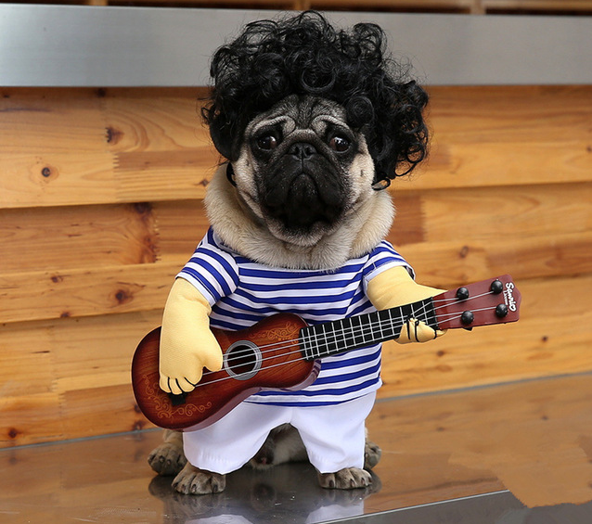
Things computers can’t do
Notes:
Problem 2: Describe what is happening in this picture.
This feels like a different kind of problem
Unlike in the previous problem, this is an example of something humans can do that machines (so far) cannot
What makes this hard for a computer, but easy for you?
Computers as we know them now
are good at learning to recognize things when they are given a lot of examples, but they’re not very accurate with completely new situations
Humans on the other hand, are really good at taking a few examples and combining them in new and creative ways
Will a future computer be able to solve this problem?

Slide 22
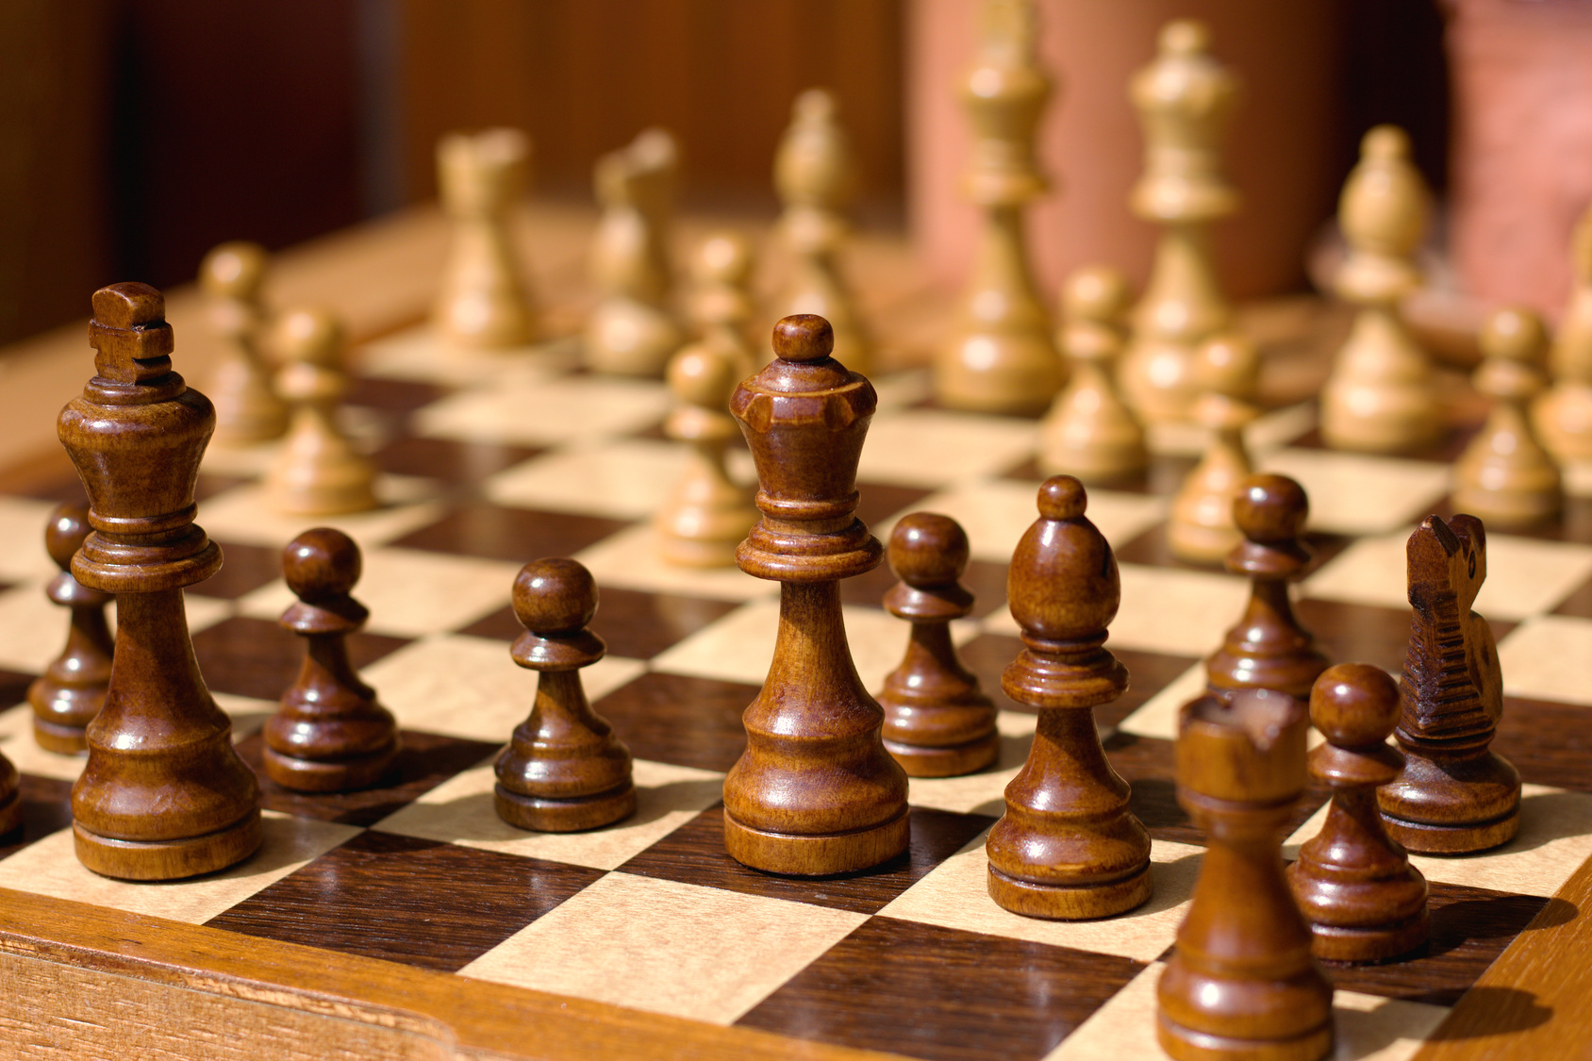
Things computers can’t do
Notes:
Problem 3: play a perfect game of chess
You might think it would be easy for a computer to win a game of chess
The rules of the game are simple, and it’s straightforward to write a program that would have a computer examine all possible moves
The problem: there are too many moves to consider
there are an estimated 10⁴³ possible games
a supercomputer checking 10¹² boards/sec would need 10²¹ years to look at them all
So here we have a new type of limitation: a practical limit
people are no better than machines at performing this task
grand masters do not consider all possible moves

Slide 23
Things computers can’t do
while (True):
print("looping...")
Notes:
Problem 4: determine if a program is stuck in an infinite loop
A famous problem in computer science is known as “the halting problem”
The goal: write a program that determines if another program is stuck
suppose you’re writing a paper and the pointer changes to the “busy” icon
it is impossible to write a “halt checker” to see if the word processor has crashed
this will become very frustrating as we get deeper into writing our own programs
This problem is related to paradoxes in logic (e.g. “this statement is false”)
a new type of limitation: a mathematical barrier
another example where people are no better than machines at solving the problem

Slide 24
Discussion: computational limits
What do you notice?
Notes:
Some tasks that computers cannot perform are also impossible for humans
the difficulty is in the nature of the problem, not the person or thing trying to solve it
A problem might not be solvable by humans or computers because
some attributes are not quantifiable (quality of life at a university)
it is impractical (chess)
it is impossible (halt checker)
Problems that humans can solve but computers can’t are often described in terms of “intelligence”
natural language processing, planning, design, ...
an active area of CS research: artificial intelligence (AI)

Slide 25
Computation (def.)
“a sequence of well-defined operations
that lead from an initial starting point
to a desired final outcome”
+
–
÷
×
AND
OR
XOR
NOT
mathematical
logical
Notes:
note this definition does not include the word “computer”
a computation is a process that can be carried out by a person or a machine
the same computation might be carried out using any one of a number of different technologies

Slide 26
Activity: computational thinking
Notes:
To explore this idea more concretely, let’s look at an example.
Everyone find a partner, and take a tractor.

Slide 27

Activity: computational thinking
FWD
R90
Notes:
This is Tango the tractor. Tango knows two operations: she can drive forward 10 feet, and she can turn 90 degrees to the right.

Slide 28
Activity: computational thinking
10ft
10ft
the 1st letter of your first name
Task 1
Task 2
Task 3

Slide 29
Activity: computational thinking
10ft
10ft
the 1st letter of your first name
Task 1
Task 2
Task 3

Slide 30
Discussion
What do you notice?
Were there any letters you couldn’t draw?
Can you tell in advance which shapes are impossible?
Notes:
Even though this example was a little silly, it illustrates many of the themes that today typify theoretical computer science. You have some well-defined set of allowed operations. Using those operations, you build all sorts of beautiful and complex structures—often reusing structures you previously built to build even more complex ones. But then certain kinds of structures, it seems you can’t build. And at that point, you have to engage in metareasoning. You have to step back from the rules themselves, and ask yourself, what are these rules really doing? Is there some fundamental reason why these rules are never going to get us what we want?

Slide 31
Computer science (def.)
“the study of computation”
Problems that can be solved computationally
Languages used to describe computational processes
Machines that carry out those processes
Theoretical limits of computation
Computational solutions to problems in math, science, medicine, business, education, journalism, ...

Slide 32

Programming language for this course
Notes:
The programming language we’ll use for the majority of this course is called python. It’s a high-level programming language, which means it’s designed to make it pretty easy for humans to express their ideas.
Throughout the semester, we’ll use python as a tool to explore computation. How many of you have heard of python before?

Slide 33
Quick cool thing: stuff written in Python

Slide 34
Goals for this and next week
Learn the basics of how a computer works
Sign up for an account on repl.it
Write simple programs that use variables, numbers, read in user input and output information

Slide 35
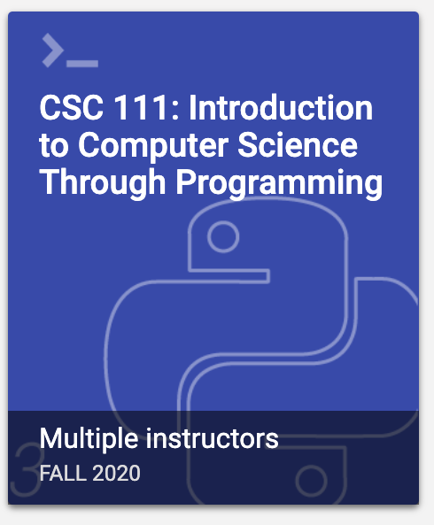

About this course: textbook
There one required e-textbook for this course:
And tons of online resources:
Sign in or create an account at learn.zybooks.com
Enter zyBook code: SMITHCSC111Fall2020
Subscribe

Slide 36
About this course: major assessments
Weekly assignments (out on Friday, due Thursday night)
There is one take home midterm in this course
One final group project with an in-class demonstration
Big idea: apply concepts we’ve learned to a domain of your choice
More on this after fall break

Slide 37
About this course: grade breakdown
Component | Weight
Homework | 40%
Labs | 20%
Midterm | 15%
Final Project | 15%
Participation | 10%
TOTAL | 100%

Slide 38
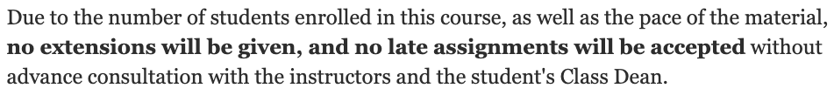
About this course: late policy
None.
Seriously.
I mean it.
However…

Slide 39
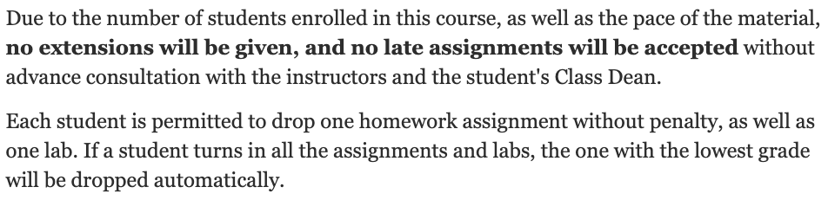
About this course: late policy

Slide 40
Resources: where to get in-person help
Join a weekly study group (see 3-minute bio to sign up)
Office hours (on Discord):
Jordan: Tuesdays 10am - noon
Shinyoung: Thursday 4pm – 6pm
TA Hours (starting next week, location TBD):
Weeknights (Sun – Thurs) 7:30pm to 9:30pm
Mornings (Mon / Wed / Fri) 8am to 10am

Slide 41


Resources: course website & syllabus
jcrouser.github.io/CSC111

Slide 42
Resources: discord (all communication)
discord.com/invite/JAfp7VF

Slide 43
Resources: moodle (lectures, slides, hw)
moodle.smith.edu

Slide 44

TODO for tonight pt. 1
Log into discord, set up desktop / phone app
discord.com/download

Slide 45
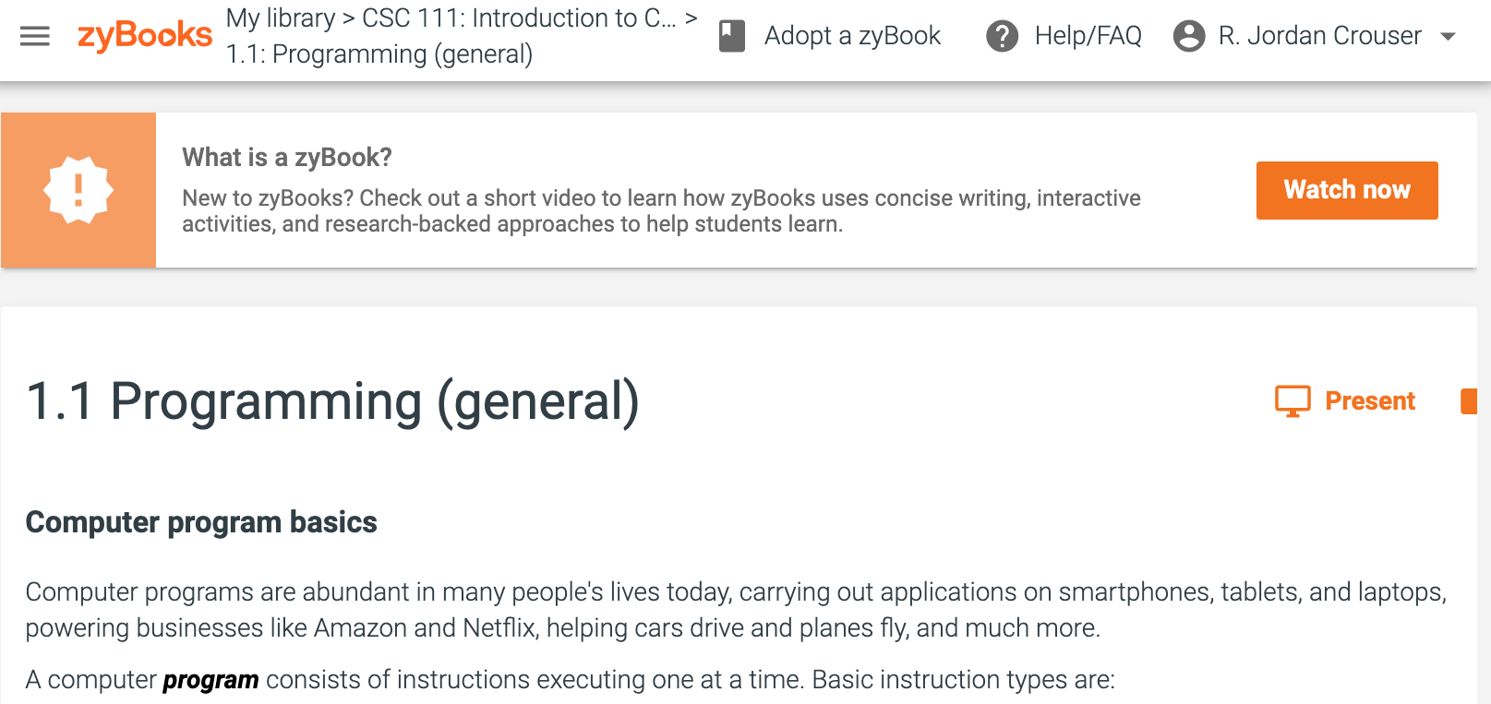
TODO for tonight pt. 2
Get a copy of the textbook at
learn.zybooks.com with code SMITHCSC111Fall2020

Slide 46
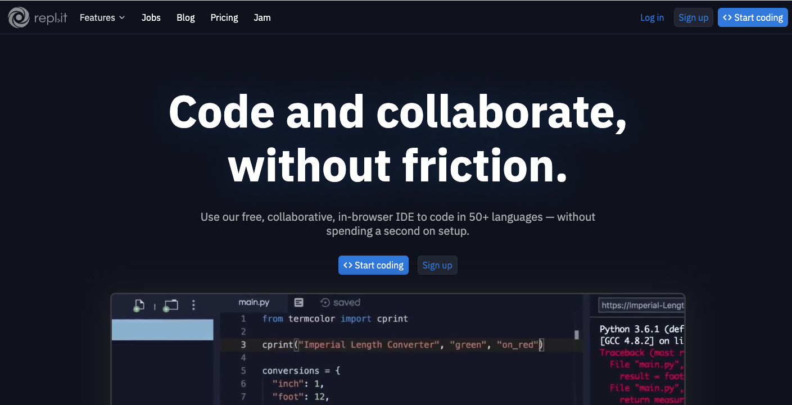
TODO for tonight pt. 3
Sign up for an account on
repl.it

Slide 47
Up next
Friday: How Computers Work
Advance reading: ch. 1.2, 1.3
Assignment 0: “How Does it Do That?”
Non-programming assignment
More on this Friday

